Slide 1
RepPoints: Point Set Representation for Object Detection
Ze Yang*, Shaohui Liu*, Han Hu, Liwei Wang, Stephen Lin
May 7, 2019
Microsoft Research Asia

Slide 2
Overview
Review of modern object detection pipelines
RepPoints: bounding box -> point set representation
RPDet: an anchor-free object detector based on RepPoints
More discussion
interpretable deformation modeling
extending RepPoints: denser (seg) and finer target (correspondence)
regression vs. discrimination

Slide 3
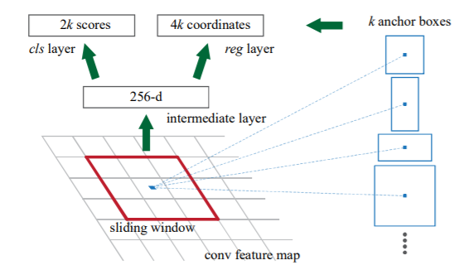
Review of modern object detection pipelines
RPN design in Faster R-CNN
RoI feature extraction in Fast R-CNN
Bounding boxes are used as anchors, proposals and final predictions.

Slide 4
Bounding boxes are used as anchors, proposals and final predictions.
Bounding box has several advantages:
Easy to be annotated
Friendly for feature extraction
Consistent with common metrics (bbox IoU)

Slide 5
Bounding box also has limitations:
Insensitive to object shape and pose (coarse localization lack of geometric information)
-> lower localization capability
Distractive background content and informative foreground content included
-> degraded feature and lower recognition capability

Slide 6
RepPoints: Point Set Representation
Bounding box vs. RepPoints

Slide 7
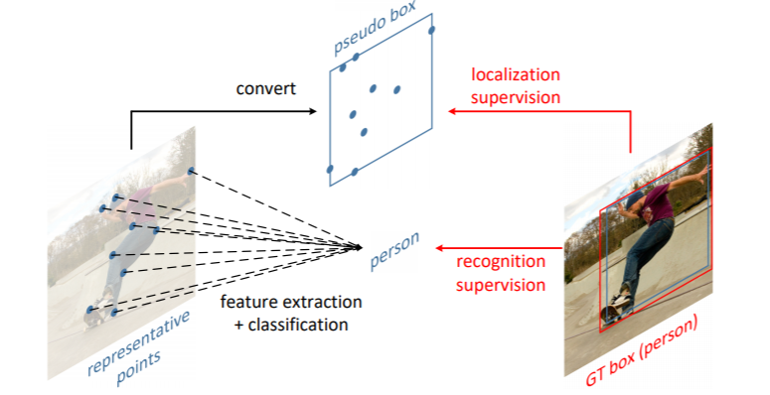
Learning Representative Points (RepPoints)

Slide 8
RepPoints: Point Set Representation

Slide 9
RPDet: an anchor-free object detector based on RepPoints

Slide 10
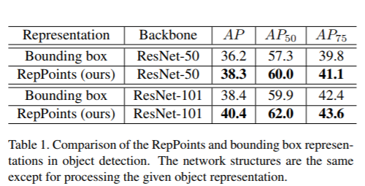
Bounding box vs. RepPoints

Slide 11
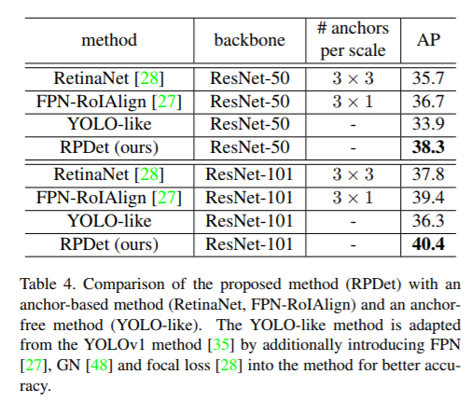
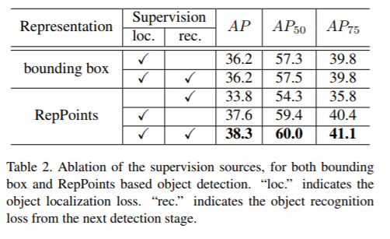
Studies on assigner, supervision and anchors for RepPoints

Slide 12
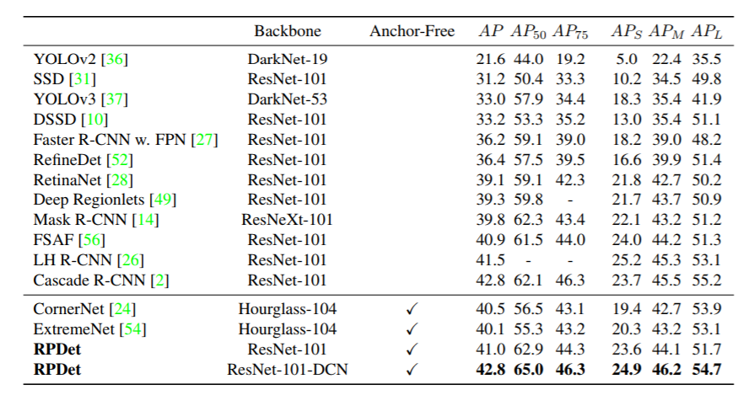
System level comparison

Slide 13
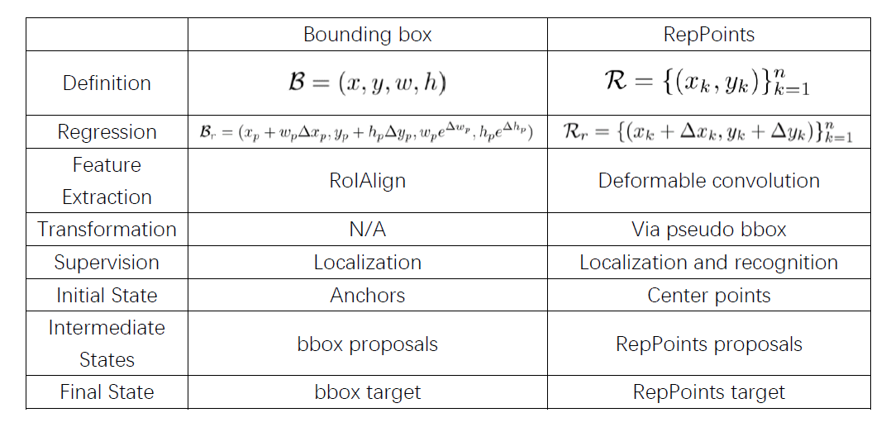

Slide 14
Discussion: some thoughts on RepPoints

Slide 15
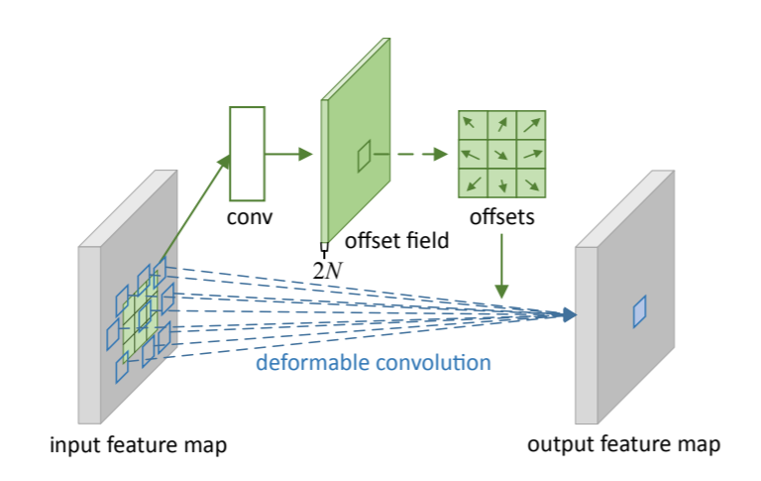
Discussion A: Interpretable Deformation Modeling
Deformable Convolutional Networks [2]
Only using recognition feedback in an implicit manner & Lacking geometric interpretation on the learned offset.

Slide 16
Discussion A: Interpretable Deformation Modeling
RepPoints: deformation modeling with explicit geometric interpretation.

Slide 17
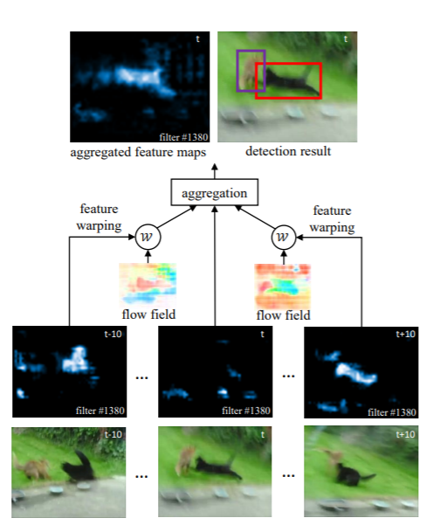
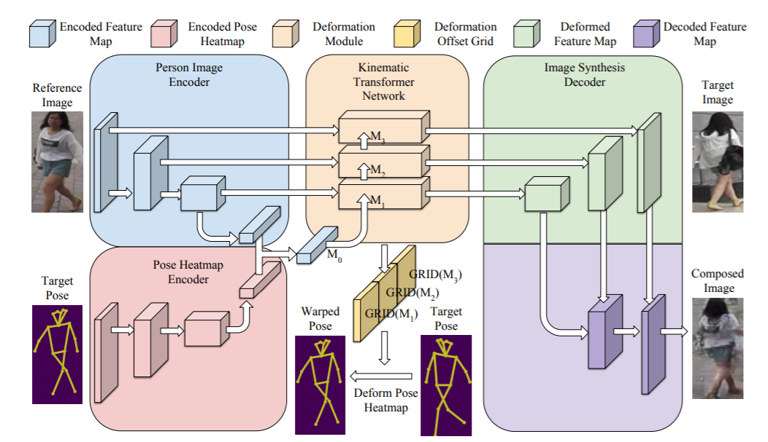
Discussion B. Extending RepPoints: Denser and Finer
Zhu et al. Flow-guided feature aggregation.
Zhang et al. Pose-guided image generation, project at Upenn.
Related Work: Deformation modeling for frame-to-frame correspondence in videos.

Slide 18
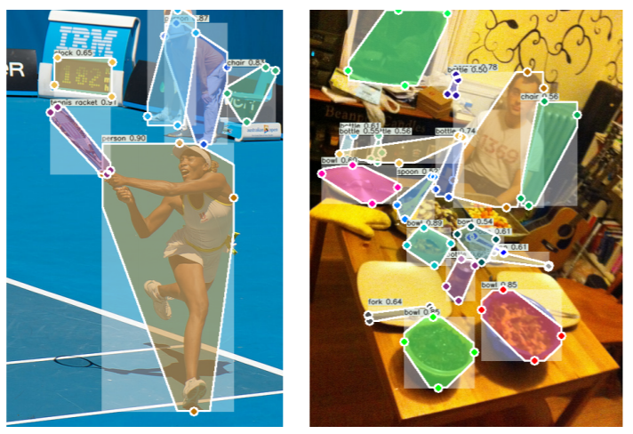
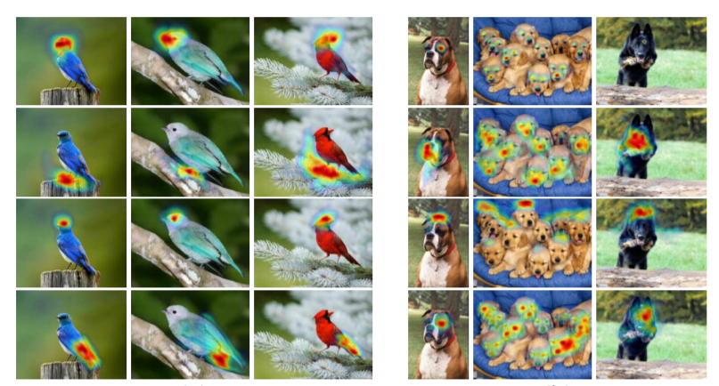
Discussion B. Extending RepPoints: Denser and Finer
Possible direction for extension: dense object perception.
Segmentation (From Zhou et al. ExtremeNet)
Semantic Correspondence (From Novotny et al. AnchorNet)
Bottleneck: to design effective and efficient guidance on RepPoints.

Slide 19
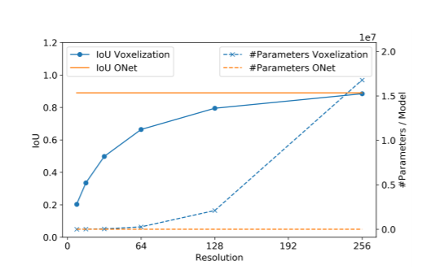
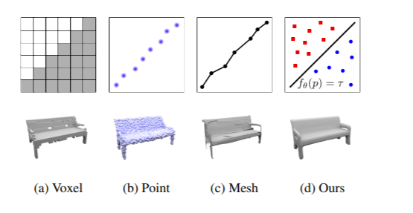
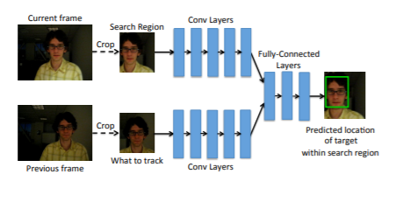
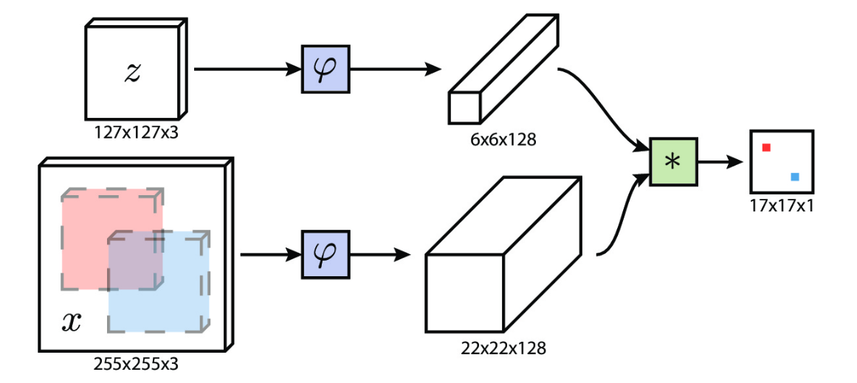
Discussion C. Regression vs. Classification
Another bottleneck: the localization ability of regression methods are lower than classification methods.
[6] discrimination vs. [7] regression
regression vs. discrimination : occupancy networks [8]
e.g. Object Tracking: reg is more efficient
e.g. 3D reconstruction: reg has higher resolution
Regression is relatively more efficient and does not need predefined proposals, while classifying each pixel is more suitable for accurate localization. Combining regression with classification can potentially reduce time complexity and number of proposals.

Slide 20
Thanks!
b1ueber2y@gmail.com
[1] Ze Yang, Shaohui Liu, Han Hu, Liwei Wang, Stephen Lin. RepPoints: Point Set Representation for Object Detection. arxiv preprint arxiv: 1904.11490.
[2] Jifeng Dai, Haozhi Qi, Yuwen Xiong, Yi Li, Guodong Zhang, Han Hu, Yichen Wei. Deformable Convolutional Networks. In ICCV 2017.
[3] Xizhou Zhu, Yujie Wang, Jifeng Dai, Lu Yuan, Yichen Wei. Flow-Guided Feature Aggregation for Video Object Detection. In ICCV 2017.
[4] Xingyi Zhou, Jiacheng Zhuo, Philipp Krähenbühl. Bottom-up Object Detection by Grouping Extreme and Center Points. In CVPR 2019.
[5] David Novotny, Diane Larlus, Andrea Vedaldi. AnchorNet: A Weakly Supervised Network to Learn Geometry-sensitive Features For Semantic Matching. In CVPR 2017.
[6] Luca Bertinetto, Jack Valmadre, João F. Henriques, Andrea Vedaldi, Philip H. S. Torr. Fully-Convolutional Siamese Networks for Object Tracking. In CVPR 2017.
[7] David Held, Sebastian Thrun, Silvio Savarese. Learning to Track at 100 FPS with Deep Regression Networks. In ECCV 2016.
[8] Lars Mescheder, Michael Oechsle, Michael Niemeyer, Sebastian Nowozin, Andreas Geiger. Occupancy Networks: Learning 3D Reconstruction in Function Space. In CVPR 2019.

