Slide 1
Normalized Diversification
CVPR 2019
Shaohui Liu*, Xiao Zhang*, Jianqiao Wangni, Jianbo Shi

Slide 2
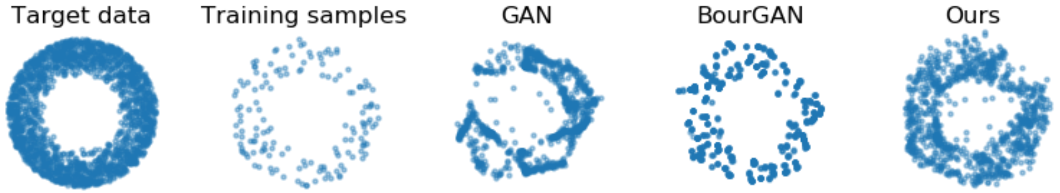
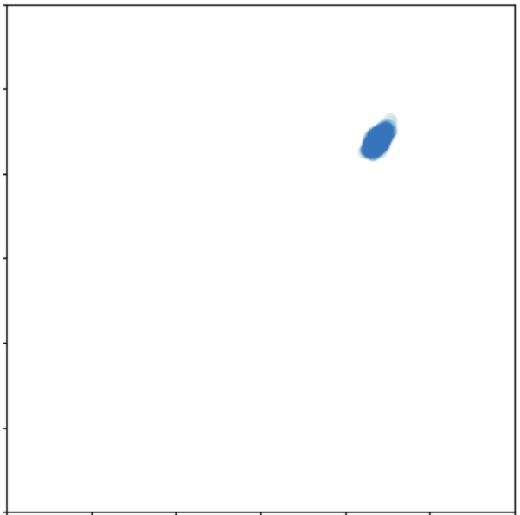
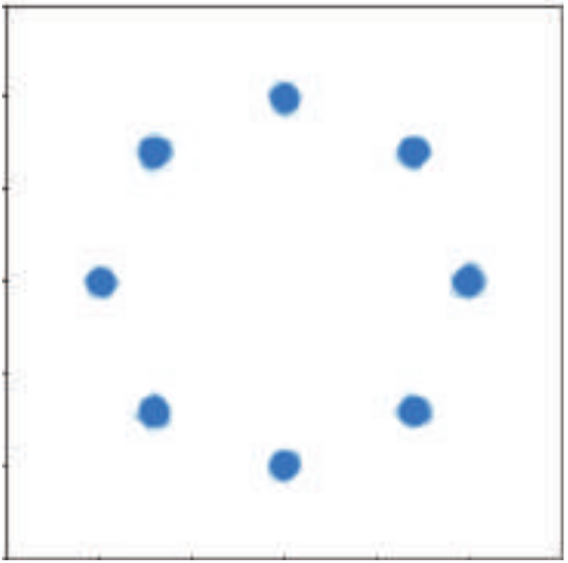
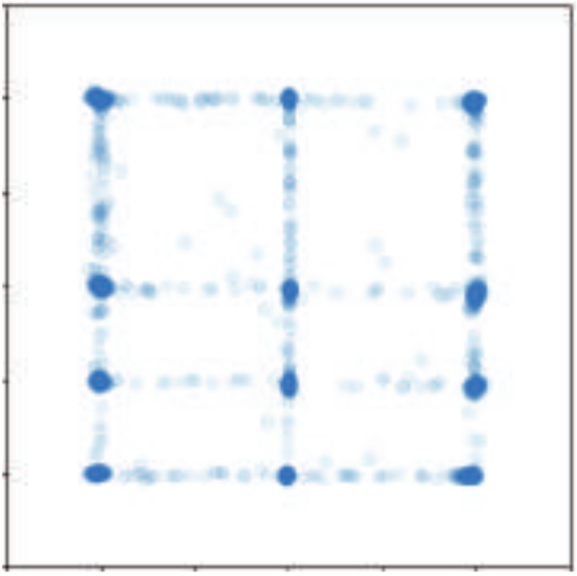
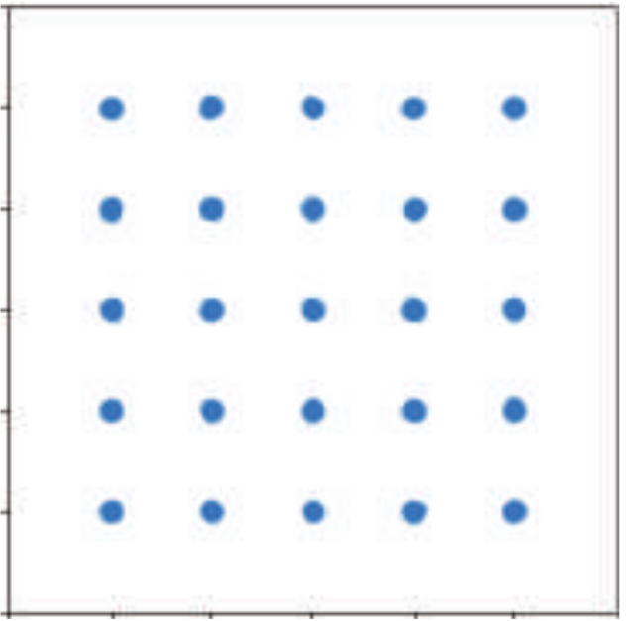
Learning a generative model for high-dimensional non-uniform space with unknown topology using sparse samples.
very complex in real-world cases.
Limitation: Mode Collapse (GAN) and Overfitting the training data (BourGAN).
GT
GAN
Motivation:
To ensure valid inner samples, i.e. to unfold. (safe interpolation)
To recover the full pattern, i.e. to diversify. (active extrapolation)
Notes:
Motivation.
Our goal is to address the complex real-world cases, where mostly we aim to learn a generative model for high-dimensional non-uniform space with unknown topology using sparse samples.
Review of existing methods. 2.1) GAN focuses more on the validity of the samples, resulting in mode collapse. 2.2) BourGAN focuses more on matching the pairwise distance, resulting in poor generalization ability.
Motivation of our method. 3.1) To address mode collapse -> to recover the full pattern -> to diversity, which is to actively expand the space. 3.2) To address generalization -> to ensure valid inner samples -> to unfold, which is to safely interpolate.

Slide 3
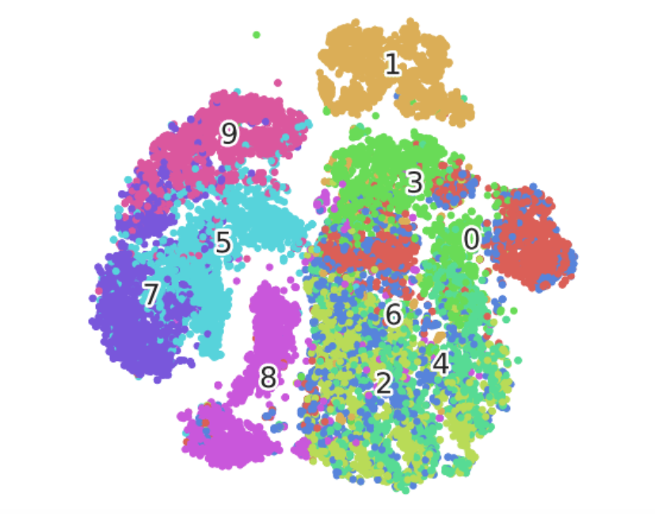
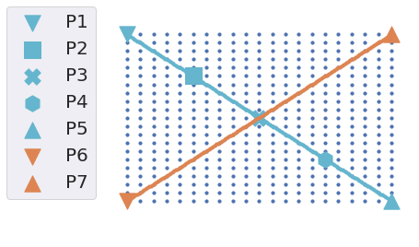
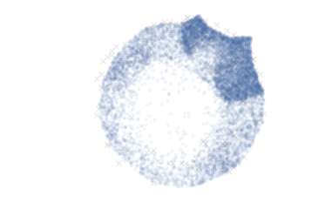
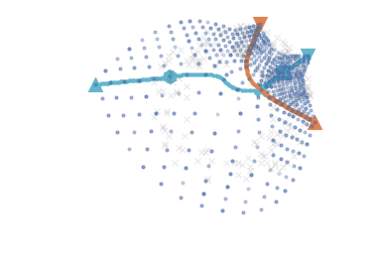
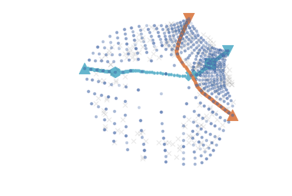
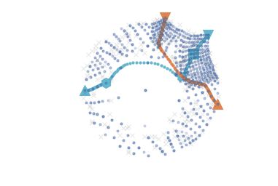
To address both mode collapse and overfitting:
the idea of manifold unfolding:
No holes. (compact encoding space)
Any paired samples can be connected with a straight line on the latent encoding space.
With manifold unfolding, we can ensure safe interpolation on the latent space, forming a compact encoding for the target data.
t-SNE for MNIST dataset, where many holes exist on the embedding space.
Latent z space Target data Iter 100 Iter 200 Iter 1000

Slide 4
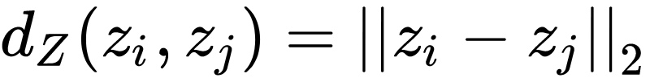
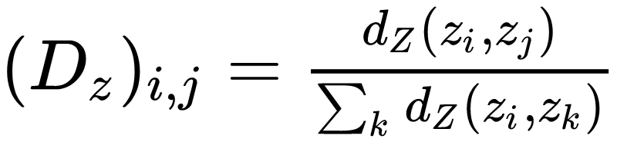
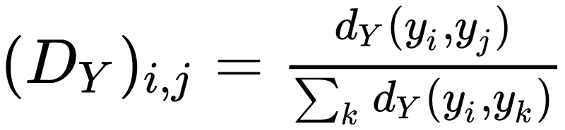
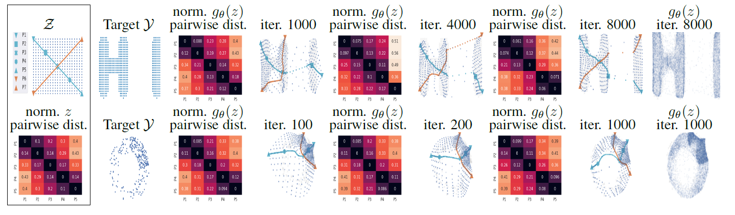
Normalized Diversification (NDiv)
z is the latent codes, y is the outputs.
safe interpolation: to preserve the relative normalized pairwise distance and unfold the manifold.
active extrapolation: we consider the denominator in Dz and Dy as constant value without gradient back-propagated.

Slide 5
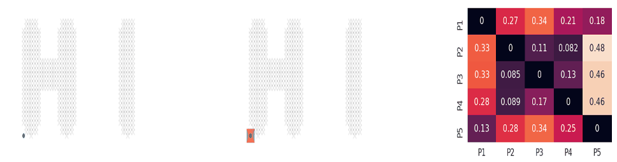
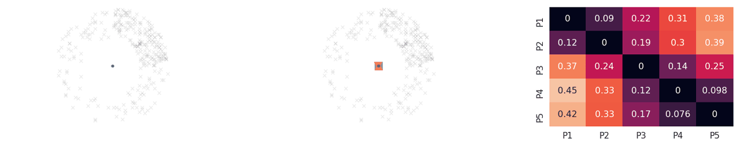
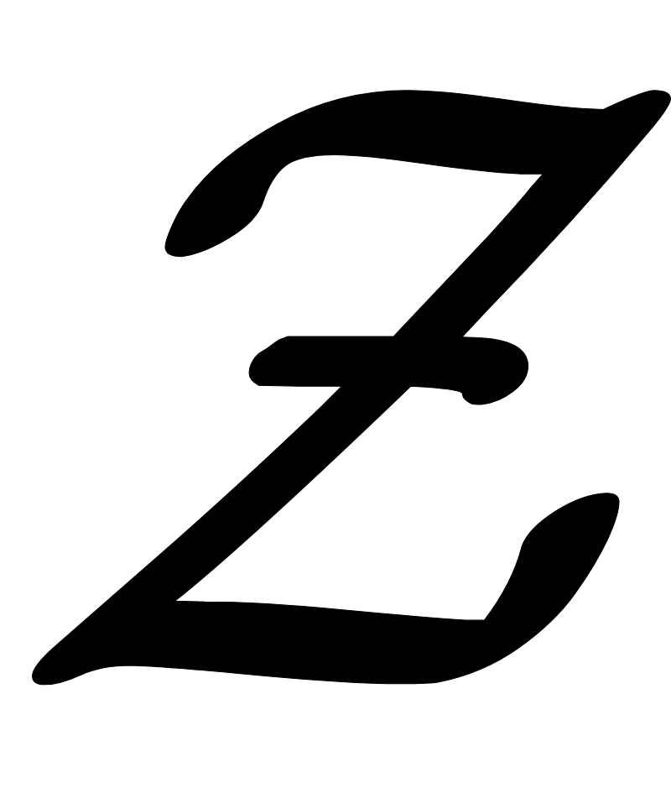
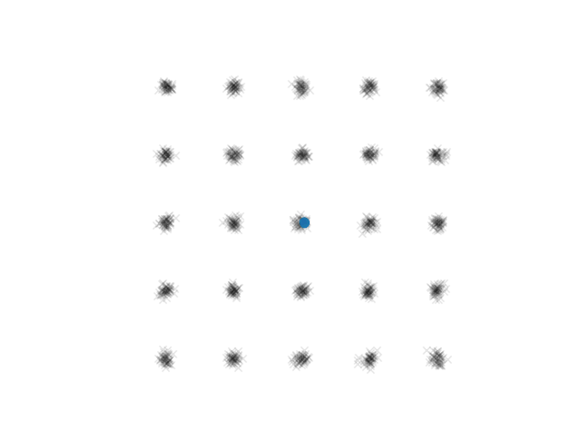
Safe interpolation:
Active extrapolation:
Two properties benefit each other alternatively throughout optimization.
uniform latent space
GT
GAN

Slide 6
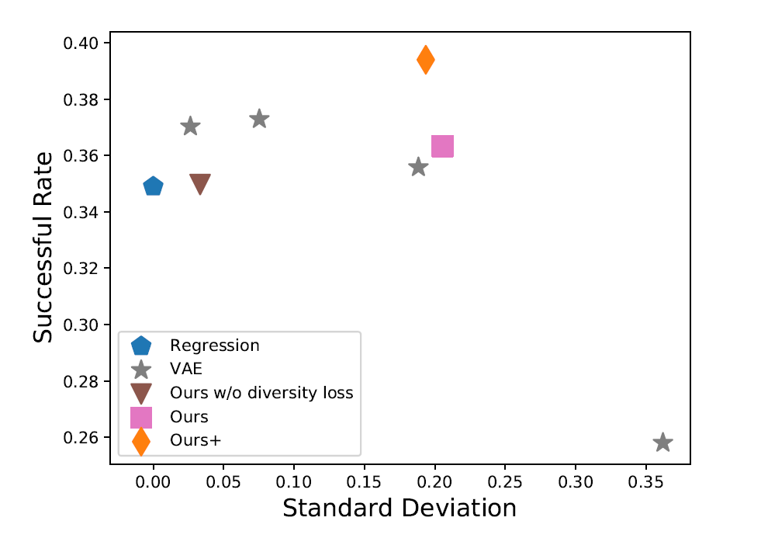
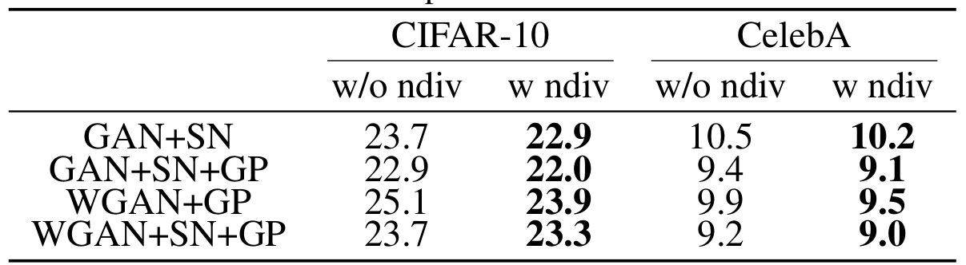
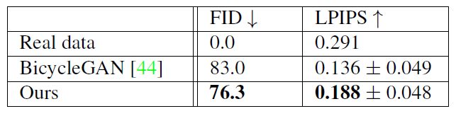
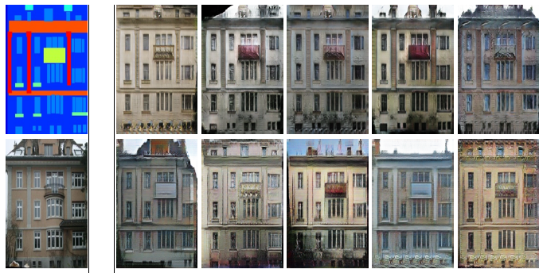
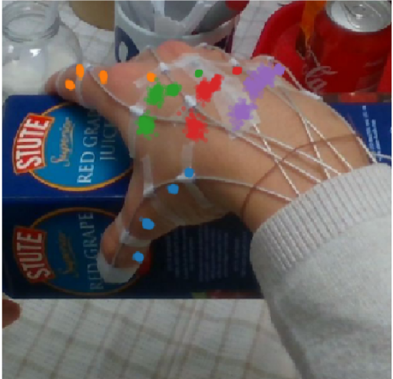
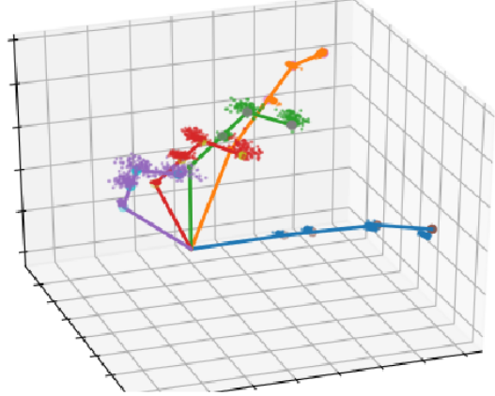
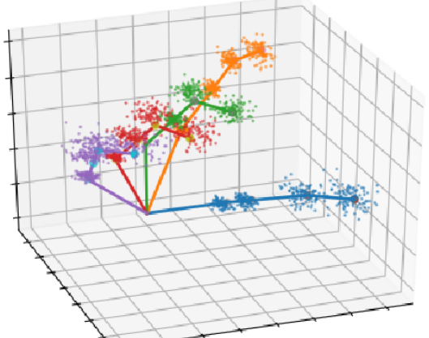
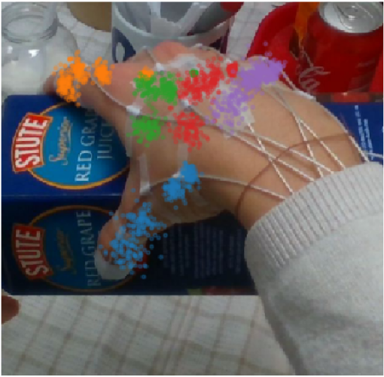
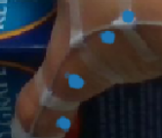
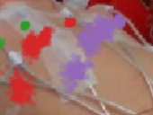
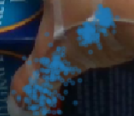
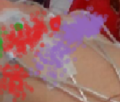
SN: spectral normalization. GP: gradient penalty.
Ours+: CGAN with high dimensional latent vector concatenated with latent code z.
Ours
VAE
BicycleGAN
Ours

Slide 7
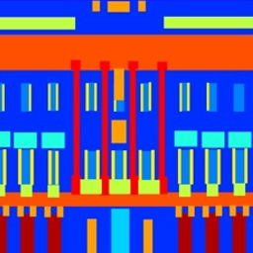
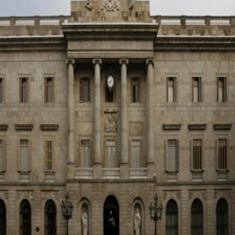
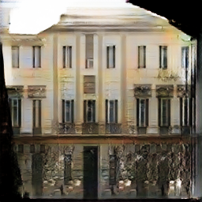
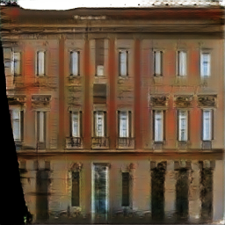
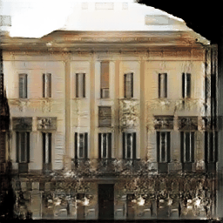
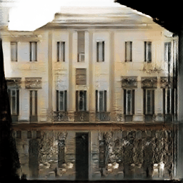
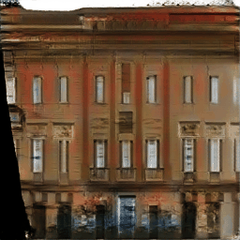
Input
Ground
Truth
Sample
Sample
extrapolation
interpolation
extrapolation

